Slide 1

Decoding LDPC Codes
ELEC 534 Final Project
December 6, 2006
Will Howison, Jeanne Guillory, David Kao, Brett Kaufman

Slide 2

Project Outline
Background Information
LDPC Code Properties
Designing code with Exit Charts
Decoders
  Belief Propagation Algorithm
  Min-Sum Algorithm
Results/Simulations

Slide 3
Introduction to Coding
What is Coding?
Why Code?
  Reliable communications/data storage
  Efficient utilization of power/bandwidth
  Mitigate interference in multi-user systems
The Coding Game
  1948: Shannon’s Challenge

Slide 4
Issues in Coding
Five primary issues in channel coding
  Probability of error
  Delay
  Complexity
  Power
  Robustness

Slide 5
Background Information
Linear Block Codes
  Generator Matrix (G)
  Parity-Check Matrix (H)
  Regular vs. Irregular
  Code Rate
  Graph Representations

Slide 6
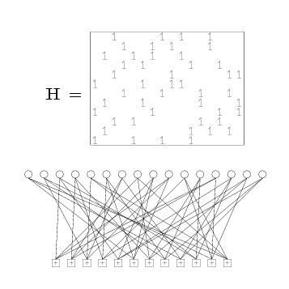
Tanner Graphs
Variable & Check nodes
  Direct visualization of H matrix
  Edges between nodes with a 1 in matrix
  Cycles increase decoding complexity

Slide 7
LDPC Codes Intro: Part 1
Low Density Parity Check Codes
History
  1963: Gallager’s Thesis [1]
  1993: Berrou, Glavieux, & Thitimajshima (Turbo Codes) [4]
  1996: Mackay & Neal [2]

Slide 8
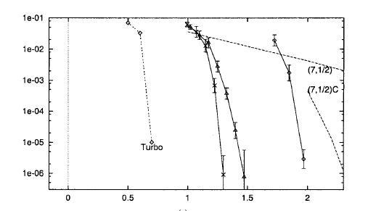
LDPC Codes Intro: Part 2
Performance Results in Literature
From [3] (left to right): ½ Rate Turbo-Code, (65389, 32621, 0.499)-LDPC, (19839, 9839, 0.496)-LDPC, (29331, 19331, 0.659)-LDPC, (7, ½)-Convolution, (7, ½)-Concatenated

Slide 9
LDPC Code Design Approaches
Gallager Regular Codes
  LDPC requires low density H matrix
  Gallagher constructs H from submatrices with column weight = 1, such that
  Column permute H1 for other submatrices
    H is regular
Other Design Approaches

Slide 10
A Code Design Approach
EXIT Charts

Slide 11
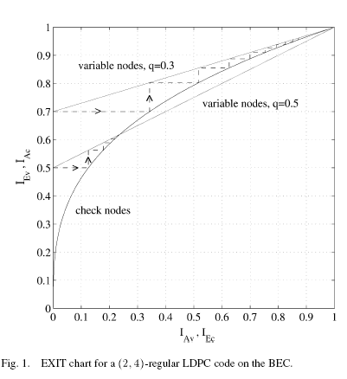
EXIT Charts
EXtrinsic Information Transfer
Transfer of Mutual Information input to the output
Top curve: Variable Nodes
Bottom Curve: Check Nodes
*Images on this slide from [5]

Slide 12
Why are EXIT charts useful?
Shows how quickly a code converges
  For a particular channel
  For a particular mapping
Can be used with a variety of codes
  LDPC, Turbo, Repeat-Accumulate, etc.
Shows a way to improve the code

Slide 13
How to make an EXIT chart
Find the log likelihood ratios at each iteration
From the LLRs find the mutual information at each iteration
  Use average mutual information over all parity checks
Plot the transfer of mutual information over successive iterations

Slide 14
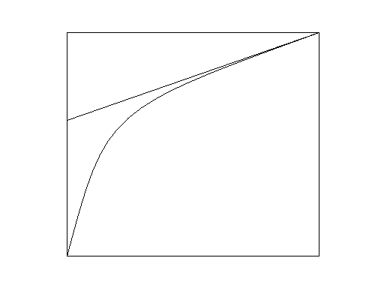
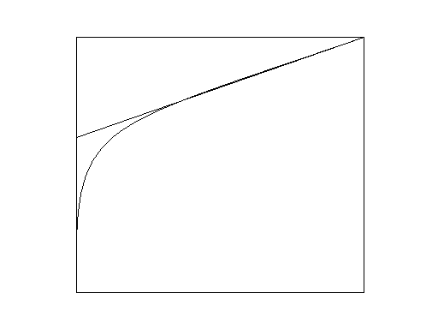
How to Design a better Code using an EXIT chart
For the BEC
  Area in the gap
  between codes is a
  rate loss compared to
  Capacity
  Use Taylor series
  expansion to curve-fit,
  coefficients describe a
  better code
EXIT charts predict convergence for other channels

Slide 15
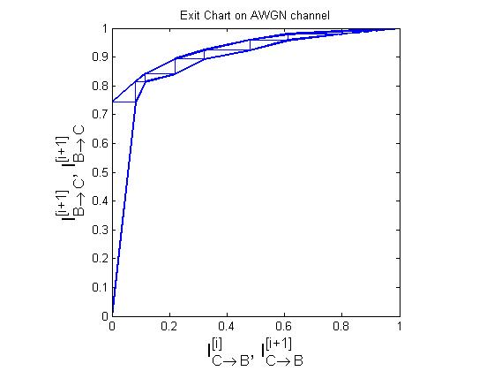
EXIT Chart using BPSK over AWGN channel with SNR = 3

Slide 16
Decoding LDPC Codes

Slide 17
Decoding LDPC Codes
Why was it hard?
  Computational Complexity
NOW: Iterative Decoding
  Belief Propagation/Message Passing/Sum-Product
  Simplifications
    APP Decoding
    Minimum-Sum

Slide 18
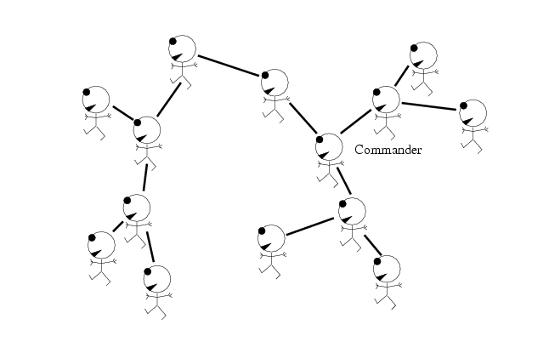
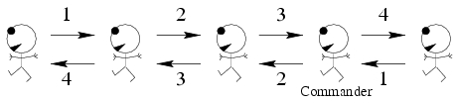
Message Passing
A Simple Example [7]

Slide 19
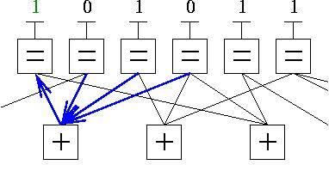
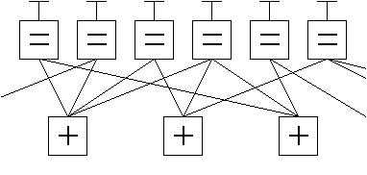
Message Passing for LDPC
BP on Tanner Graph
Issues:
  Memory and Computation
  Loops
*Images on this slide courtesy of Wikipedia

Slide 20
Minimum-Sum
Min-sum simplifications
  Approximate a checksum probability by the minimum received value
  Apply a sum over bit estimates using this “confidence level”
Reduced comp values [6]
(N,J,2J) | Sum-Product | Min-Sum
Additions | 3NJ + N | N/2(2J+[log₂2J]–2) +3N(J-1)
Multiplications | 11NJ – 9N | 0
Divisions | NJ + N | 0

Slide 21
Simulation Results

Slide 22
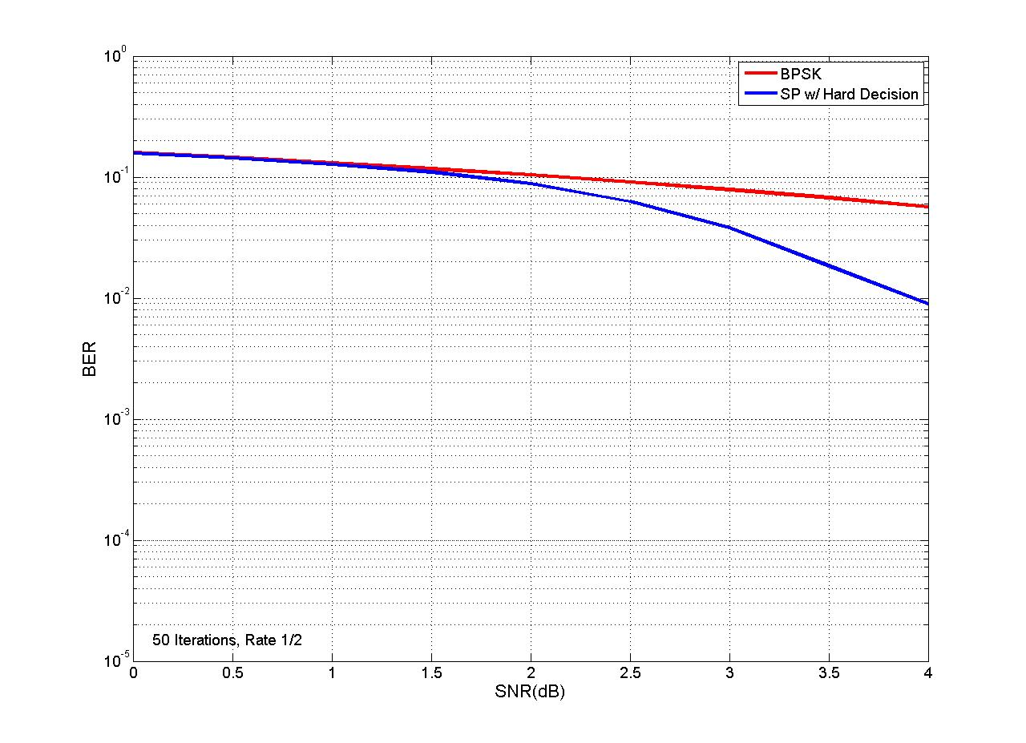
Binary Symmetric Channel

Slide 23
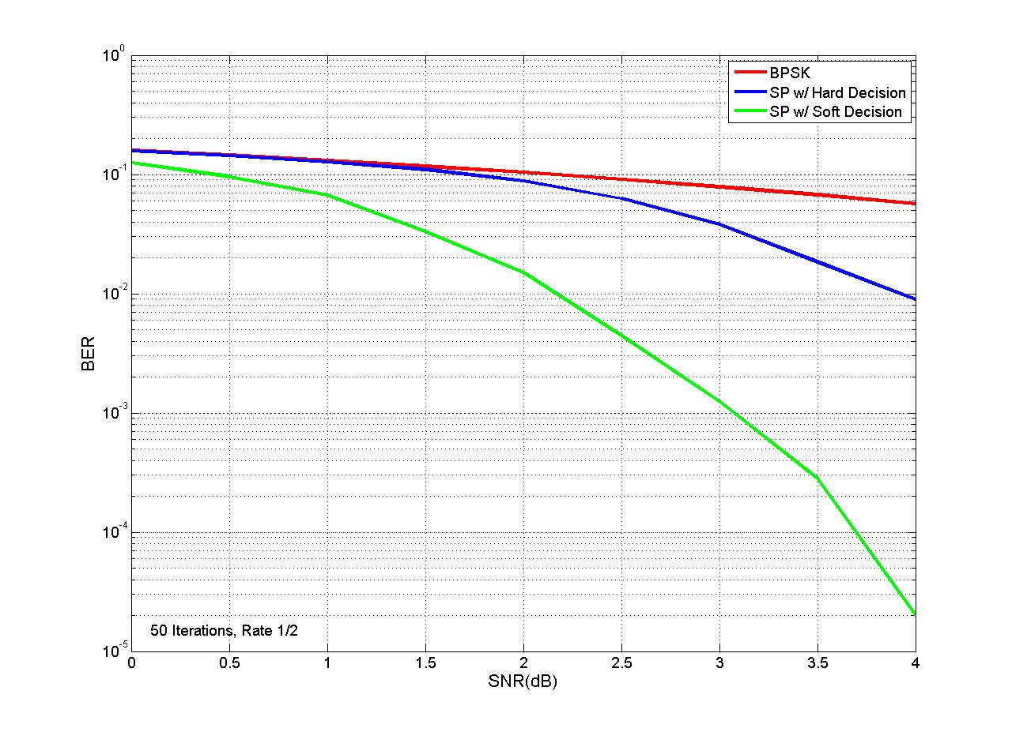
Hard vs. Soft Input

Slide 24
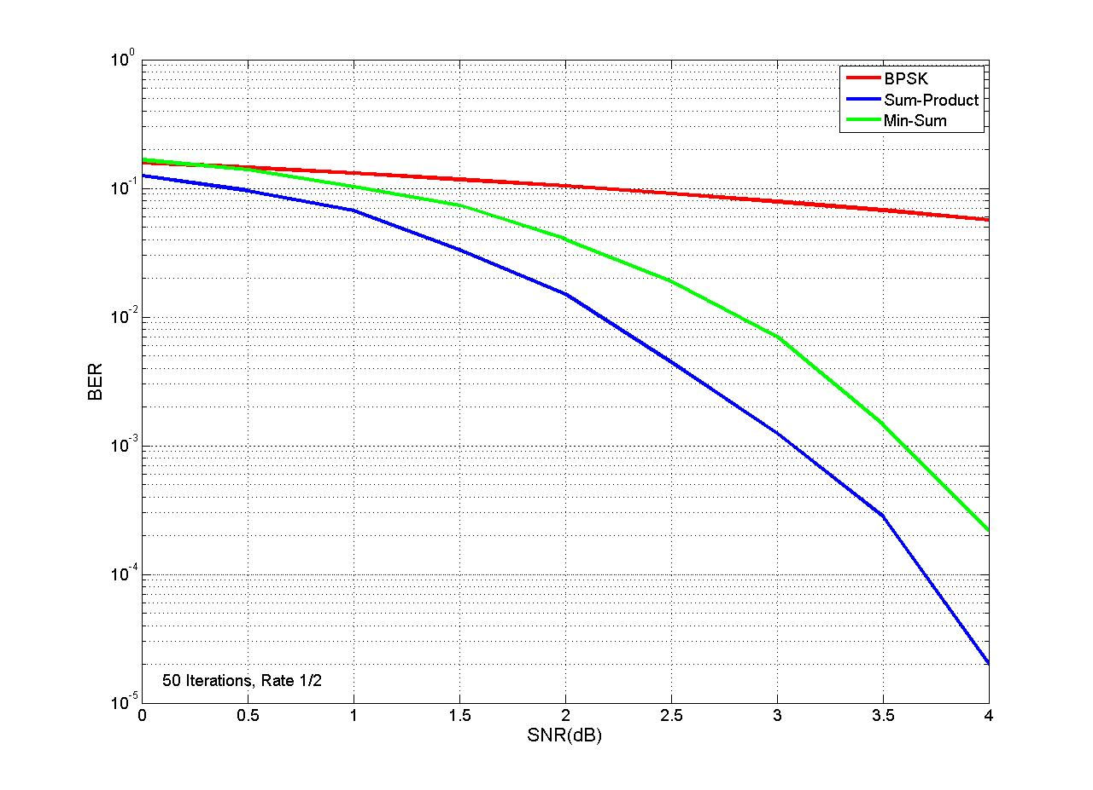
Algorithm Comparison

Slide 25
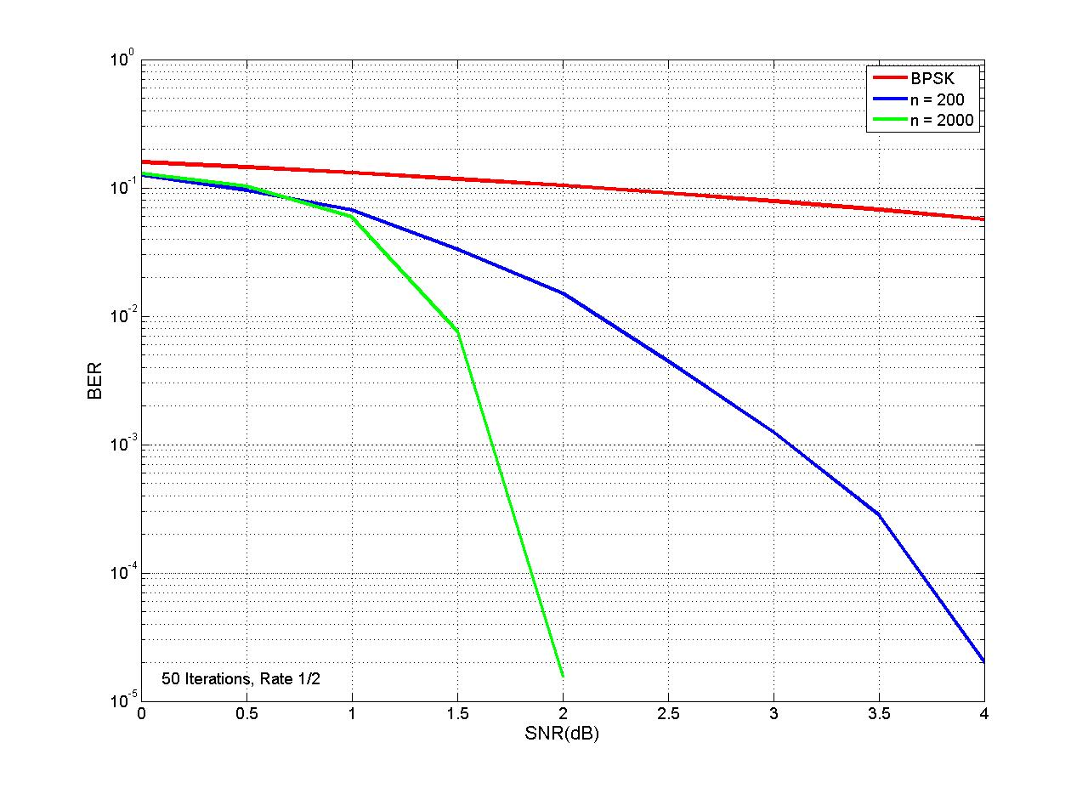
Block Length (Delay)

Slide 26
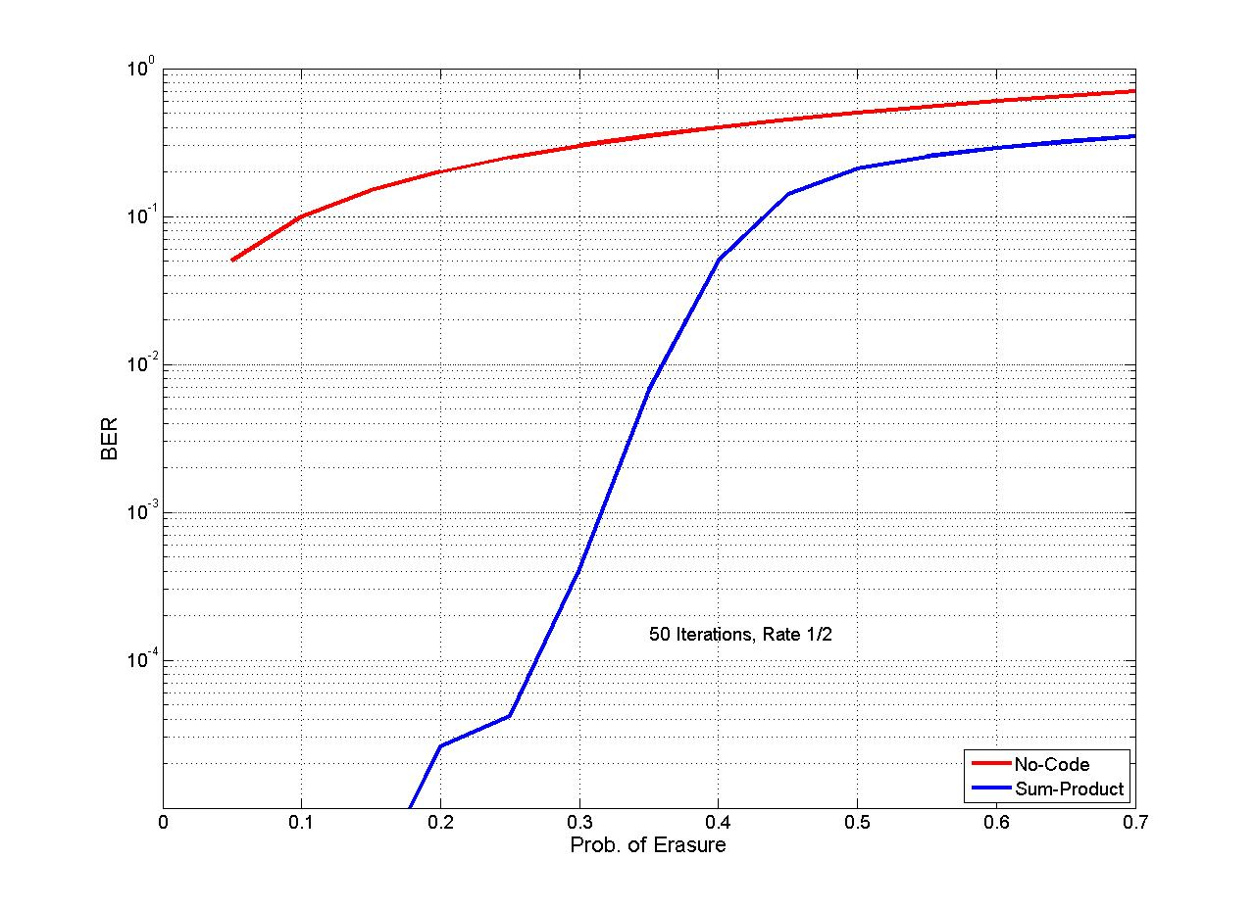
Binary Erasure Channel

Slide 27
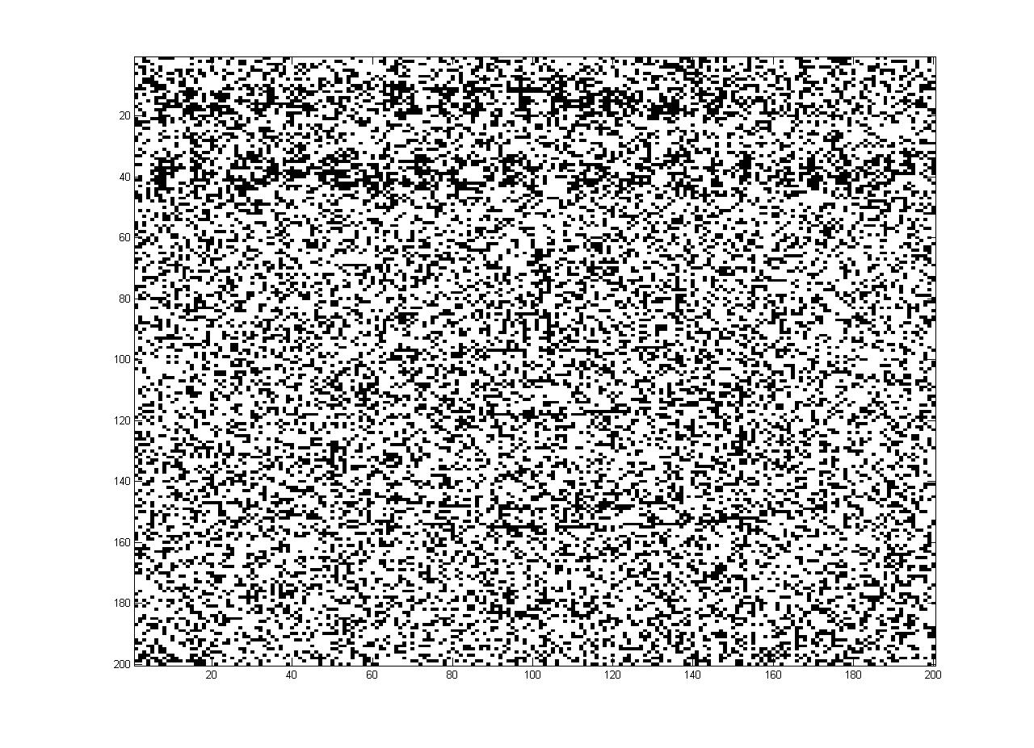
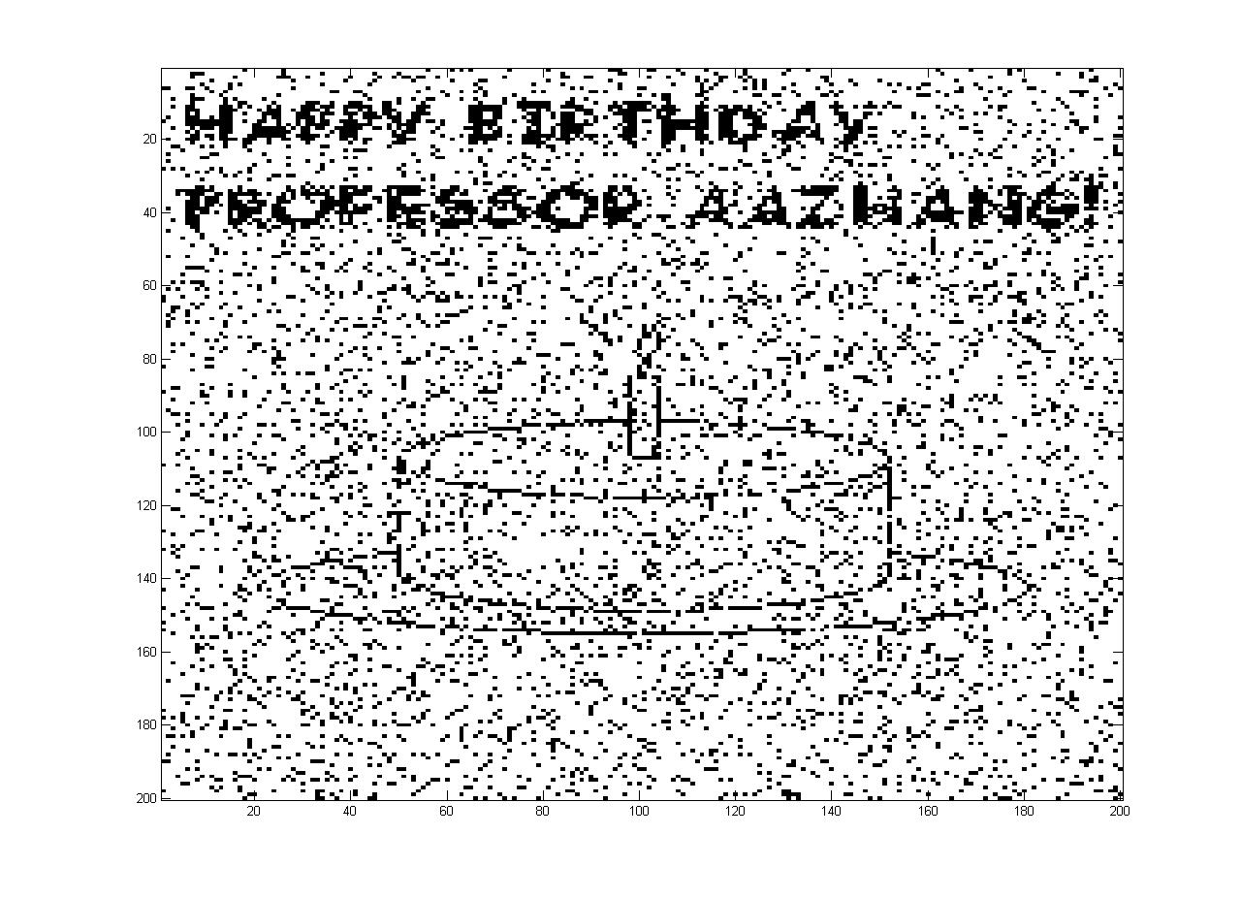
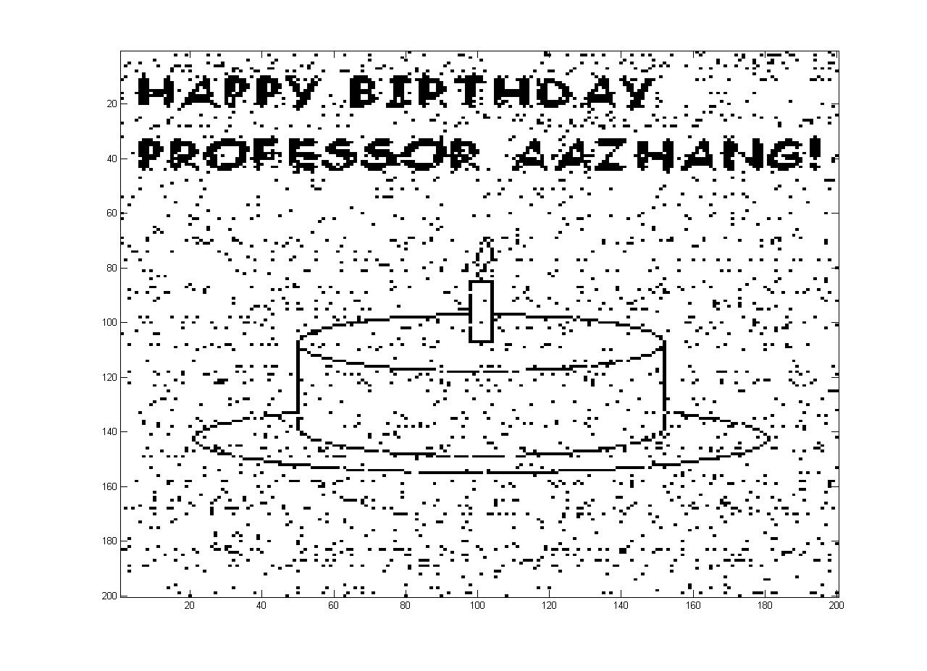
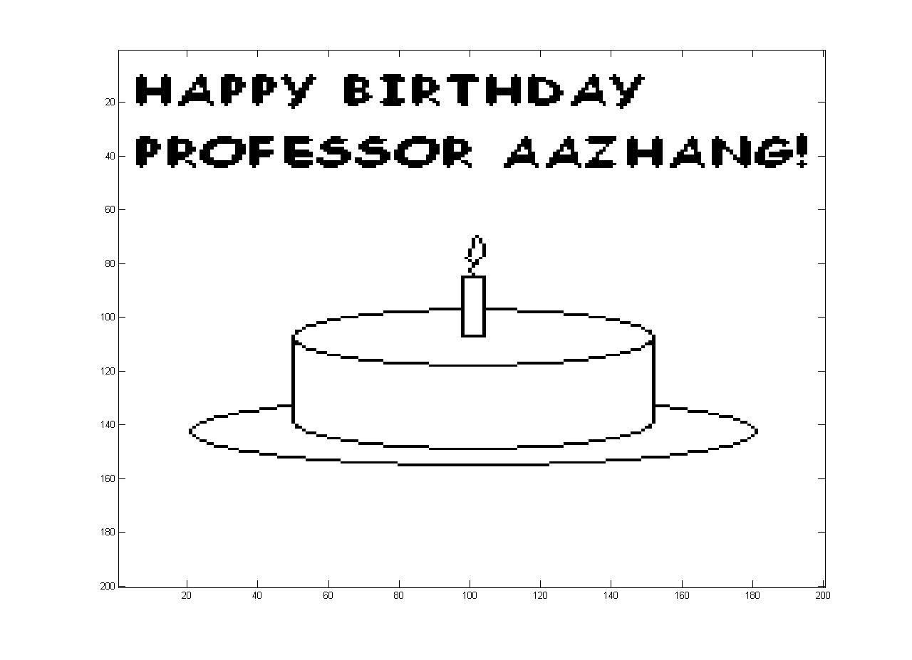
Iterative Decoding

Slide 28
References
[1] R. G. Gallager, “Low density parity-check codes,” IRE Trans. on Info. Theory, vol. 8, pp. 21–28, 1962.
[2] D. J. C. MacKay and R. M. Neal, “Good codes based on very sparse matrices,” Electron. Lett.,vol. 32, no. 18, pp. 1645-1646, Aug. 1996.
[3] D. J. C. MacKay, “Good error-correcting codes based on very sparse matrices,” IEEE Trans. On Inform. Theory, vol. 45, pp. 399-431, Mar. 1999.
[4] C. Berrou, A. Glavieux, and P. Thitimajshima, “Near Shannon limit error-correcting coding and decoding: Turbo-codes,” in Proc. 1993 IEEE Int. Conf. On Communications (Geneva, Switzerland, 1993), pp. 1064-1070.
[5] A. Ashikman, G. Kramer, and S. ten Brink, "Extrinsic information transfer functions: model and erasure channel properties," IEEE Trans. on Info. Theory, vol. 50, no. 11, pp. 2657-2673, 2004.
[6] M. Fossorier, M. Mihaljevic, and H. Imai, “Reduced complexity iterative decoding of low density parity check codes based on belief propagation,” IEEE Trans. Commun., vol. 47, pp. 673-680, May 1999.
[7] D. J. C. MacKay, Information Theory, Inference, and Learning Algorithms. Cambridge, UK: Cambridge University Press, 2005.
[8] T. K. Moon, Error Correction Coding: Mathematical Methods and Algorithms. Hoboken, NJ: John Wiley & Sons Inc., 2005.
[9] T. Richardson and R. Urbanke. (2006) Modern coding theory. mct.ps. [Online].Available: http://lthcwww.epfl.ch/mct/index.php

Slide 29
Questions???

Slide 30
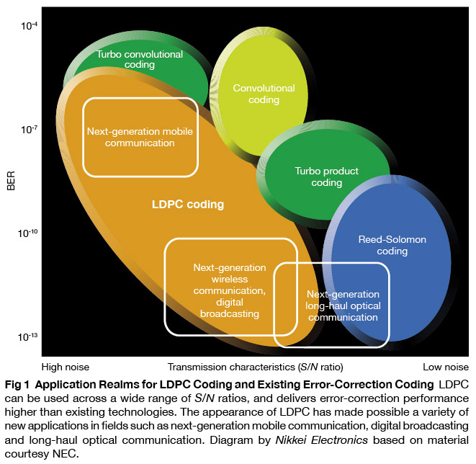
Q1: LDPC vs Turbo!
Turbo approaches capacity faster
  But what about the error floor??
Computational complexity
Convolutional/ Turbo codes ARE LDPC Codes [3]
Silicon

Slide 31
Q1: LDPC vs Turbo!

